Slide 1

Revolutionizing Robotics: A Smartphone-Controlled Robotic Hand
Artificial Intelligence and Robotics (19CSE455)
End Sem Presentation
30-05-2024
Team-17
Team Members
J. Sri Sai Samhitha -BL.EN.U4CSE21072
Kuthati Shreya – BL.EN.U4CSE21108
Lasya Priya Divakarla-BL.EN.U4CSE21111

Slide 2
Contents
Introduction
Problem Statement
Related Work
Research Gap
Research Methodology
Results and Discussion
Conclusion

Slide 3
Introduction
Recent technological advancements, particularly within the domain of the Internet of Things (IoT), have catalyzed the creation of novel solutions designed to improve efficiency and precision.
This endeavor entails the introduction of a fixed robotic hand that can be operated using a mobile application, enabling users to control all five fingers, including their individual movements, for activities like remote object manipulation.
By utilizing an Arduino Uno with in conjunction with a Bluetooth module, seamless communication between the mobile device and the robotic hand is established.
The mobile application captures and sends user instructions via Bluetooth to the Arduino, which coordinates the servomotors propelling the robotic fingers.
This configuration guarantees accurate and prompt manipulation, demonstrating the sophisticated integration of contemporary technology and human interaction, making it indispensable for tasks that require delicate and precise handling.
The potential applications of this innovative system are diverse, spanning sectors such as manufacturing, healthcare, accessibility solutions, research, and education, thus underscoring its adaptability and significant impact.

Slide 4
Problem Statement
Developing a smartphone-controlled robot hand tailored for physically handicapped individuals to improve their autonomy and quality of life by enabling independent manipulation of objects and daily tasks. The project aims to create an intuitive interface via a smartphone app, integrate precise control and feedback mechanisms, and ensure compatibility with existing assistive devices, fostering inclusivity and empowerment for users with physical disabilities.

Slide 5
Related Work
Yusoff et al. engineered a wireless robotic arm optimized for pick-and-place operations, effectively overcoming challenges associated with remote object manipulation and hazardous material handling. Their project seamlessly amalgamates hardware and software components to forge a dependable system for wireless control. By leveraging the Arduino Mega platform as the interface for the robot and integrating a PS2 wireless controller for precise movement control, they ensure seamless operation. The wireless mobile robotic arm exhibits prowess in pick-and-place tasks, enabling wireless directional movements such as forward, reverse, right, and left. Furthermore, their performance analysis encompasses evaluations of speed, distance, and load capacity, offering valuable insights into the robot's capabilities and its potential for real-world applications.
Mohammed Ali et al. embarked on a comprehensive project focused on designing and fabricating an Arduino-based robotic arm controllable via a mobile application. Employing software design tools and 3D printing technology, the team meticulously crafted the mechanical components necessary for the project's realization. The robotic arm, equipped with six servo motors, including MG945 and MG90S Micro servos, underwent meticulous design and assembly processes facilitated by SolidWorks and 3D printing techniques. The accompanying mobile application, developed utilizing MIT App Inventor, boasts an intuitive interface comprising a Bluetooth enabling button and six sliders for individual servo motor control. The project underscores the significance of proficiency in Arduino programming, as evidenced by the successful testing of the robotic arm's functionality via wireless Bluetooth signals transmitted from the mobile application. The culmination of the project in the assembly and testing of a functional prototype serves as a testament to the efficacy of combining mechanical engineering, software development, and robotics to yield tangible solutions.

Slide 6
Related Work
Safaric et al. explore the use of Virtual Environments (VE) for educational and training purposes, focusing on task planning conducted in a virtual world and then transferred to physical hardware for real-world execution. They develop RLab, a remote laboratory system seamlessly integrated with an online video system for telerobotics training experiments. The process involves crafting robot tasks within a virtual environment on the RLab server's webpage, conducting collision detection, and transmitting completed task files to a laboratory execution computer for task execution. Matlab with xPC is utilized for servo drive position control, and a non-immersive VR environment with teach pendants is used for simulating robot activities and collision detection before executing tasks on remote hardware. Evaluations highlight the system's ability to configure experiments, download data, verify execution results to prevent collisions, and ensure user safety, providing real-time feedback and a live video feed of the robot arm's actions.
Li-Hu Jhang et al. [4] A wireless sensor-based glove controller has been designed to control a mobile robot [4]. This model has several sensors and control modes that allow for wireless control over the robotic arm to perform different human tasks. A 6-axis robotic arm has been used in this approach. The model has been designed to do basic human tasks like picking up things and placing them etc. The main motive of this model is to assist people in performing human tasks at industries with enhanced safety.
Shamman Noor et al. [5] An “Artificial Human Hand Model” has been proposed that is capable of performing actions like base rotation, grip motions, elbow motions, grip rotation, etc. [5]. A webcam has been used to capture the human actions that will be mimicked by the model. Distant control in this model allows flexibility to control distant objects alongside ensuring human safety. The main focus of this model is to capture and perform the finger actions.

Slide 7
Related Work
Keerthi Premkumar et al. An android application-based control for a robotic arm has been designed [6]. The robotic arm is set to perform human tasks, Raspberry Pi has been connected over Wi-Fi to the Android phone to control the robotic arm. A Python program written in the Raspberry Pi acts as the central control. This model has been developed to replicate human tasks so that repetitive actions by these robot controls.
Ahmed et al. [7]In the proposed model an Arduino ESP32 microcontroller was used along with four servo motors to enable the robotic arm to perform pick and place tasks. Commands are sent wirelessly through a web interface designed with HTML which interacts with controller using a WIFI router . Ultra sonic sensors are incorporated to ensure precision in arm’s movements. The Proteus software is used to simulate the system before physical implementation. The main aim of this project is to enhance efficiency and safety in industrial environments by automating manual tasks which can be hazardous to workers.
Bhargava et al. [8]A robotic arm whose degree of freedom is 5 has been developed. It is integrated with an Arduino Uno microcontroller which accepts inputs from user using a set of potentiometers. The arm consists of 4 rotary joints and an end effector where rotary motion is provided by a servomotor. The servo motors and links are assembled with fasteners to produce the final shape of the arm. The Arduino has been programmed to provide rotation to each servo motor corresponding to the amount of rotation of the potentiometer shaft.
Lee et al. [9]In this paper an efficient wireless control protocol for a small scale robotic arm has been developed. The system incorporates joysticks , two Arduino microcontrollers communicating via RF transmission link and a servo controller. The robotic arm is designed to pick objects weighing up to 200 g with a gripper opening of 42 mm. This project aims to address the industrial need for automation of repetitive tasks , enhancing accuracy and speed while reducing costs.

Slide 8
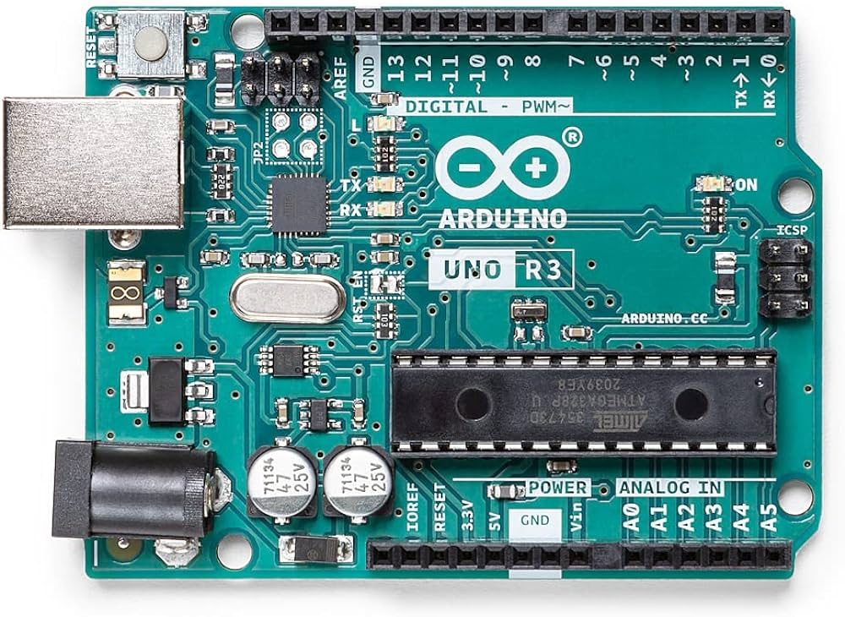
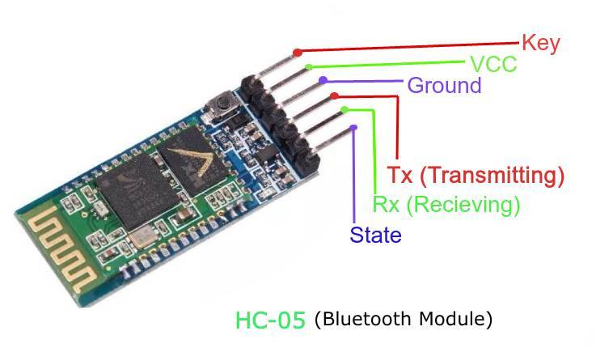
Methodology – Components Used
Arduino UNO
the Arduino Uno DIP serves as the central microcontroller, interfacing with sensors and actuators to receive commands from the smartphone app via Bluetooth. It processes these commands to control the movement and position of the robot fingers accordingly, ensuring precise and responsive manipulation based on user input.
HC-05 Bluetooth Module
HC-05 Bluetooth module for a smartphone-controlled robot finger project with an Arduino, first connect the HC-05 module to the Arduino. Then write a program (Arduino sketch) that allows the Arduino to communicate with the HC-05 module and interpret commands sent from a smartphone. These commands will control the movement of the robot fingers. Finally, you'll develop a smartphone application that establishes a Bluetooth connection with the HC-05 module and sends commands to the Arduino. This setup enables users to wirelessly control the robot fingers from their smartphones.

Slide 9
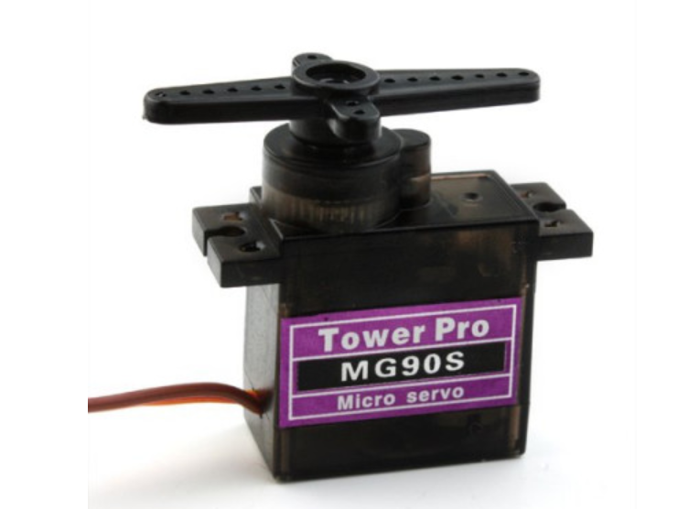
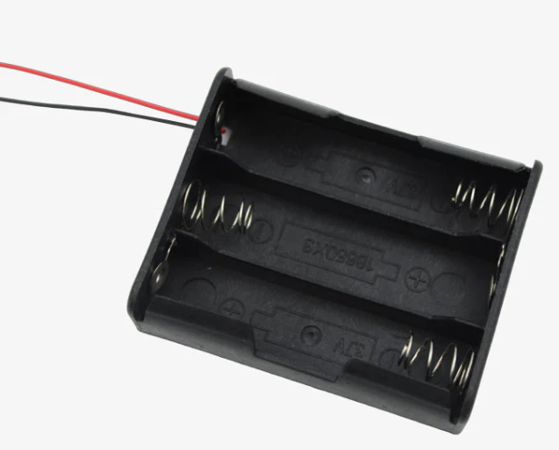
Methodology – Components Used
Hardware Componets
MG90S servo motors
The MG90S servo motors are connected to the robotic fingers of your project. The HC-05 Bluetooth module is wired to the Arduino microcontroller, which acts as the brain of your setup. When you send commands from your smartphone via a Bluetooth connection to the HC-05 module, the Arduino interprets these commands and moves the servo motors accordingly.
Cell Holder:
A cell holder is a container designed to hold batteries securely in place. It usually has metal contacts that make electrical connections with the battery terminals.

Slide 10
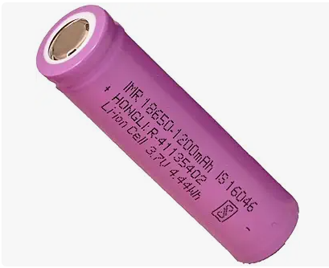
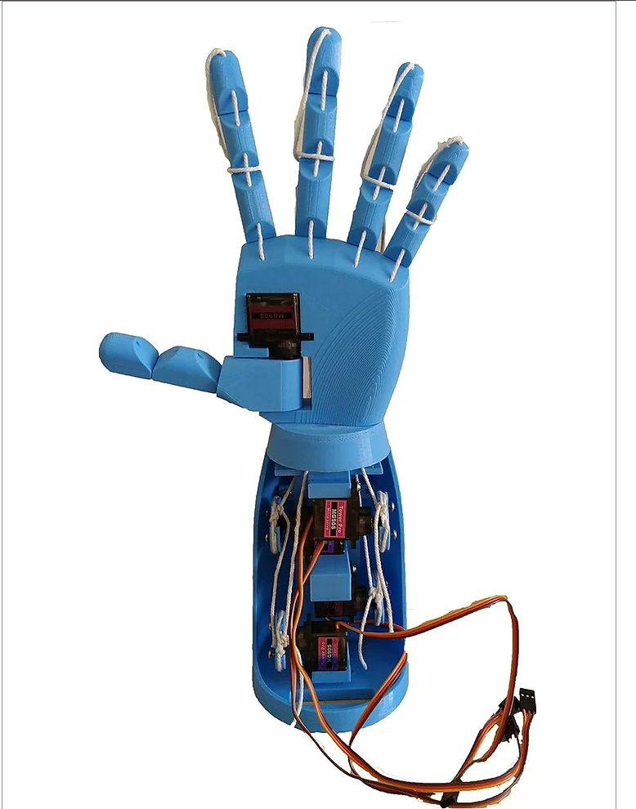
Methodology – Components Used
18650 Cells:
18650 cells are a type of rechargeable lithium-ion battery commonly used in electronic devices. These cells provide a reliable and long-lasting power source for projects like your prosthetic robot hand. When fully charged, they can deliver a voltage of around 3.7 volts, which is suitable for powering servo motors and other electronic components in your hand.
Prosthetic Robot Hand:
A prosthetic robot hand is a robotic device designed to mimic the function of a human hand. It typically consists of mechanical fingers or digits that can be controlled to grasp and manipulate objects. In your project, the prosthetic robot hand would be the physical structure that houses the servo motors, gears, and other components necessary for finger movement.

Slide 11
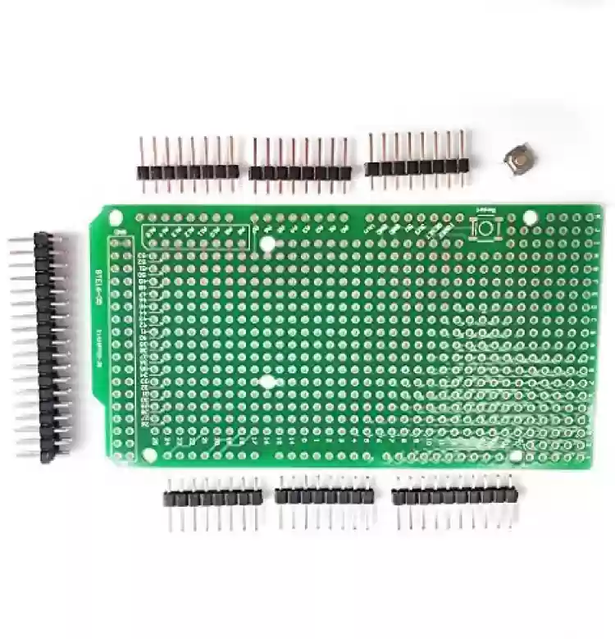
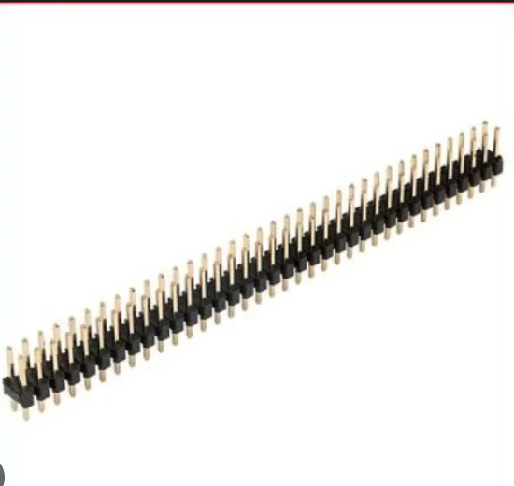
Methodology – Components Used
Printed Circuit Board
The Printed Circuit Board (PCB) plays a vital role by centralizing all electronic components and connections, ensuring reliable performance. It routes signals and power efficiently to various parts of the prosthetic hand using etched copper traces, reducing wiring clutter and minimizing potential failure points. The PCB organizes components like the Arduino UNO, HC-05 Bluetooth module, and servo motor connectors compactly, enhancing system robustness.
Berg Sticks
Berg sticks, also known as header pins or pin strips, play a vital role in enhancing the modularity and flexibility of the prosthetic hand project. These components are soldered onto the PCB to provide convenient connection points for various modules and peripherals. By using Berg sticks, each electronic component, such as the Arduino UNO, servo motors, and the HC-05 Bluetooth module, can be easily plugged into or removed from the PCB.

Slide 12
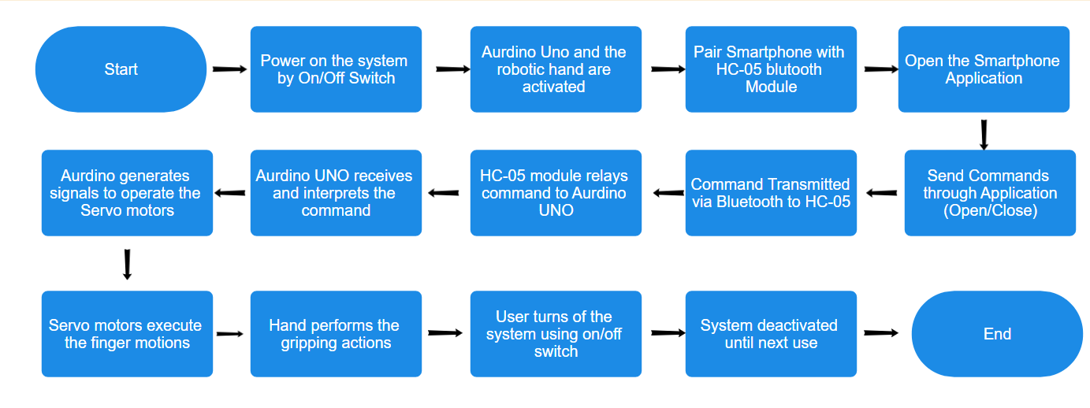
Flow Diagram
Fig : Flow diagram representing sequence of the project steps.

Slide 13
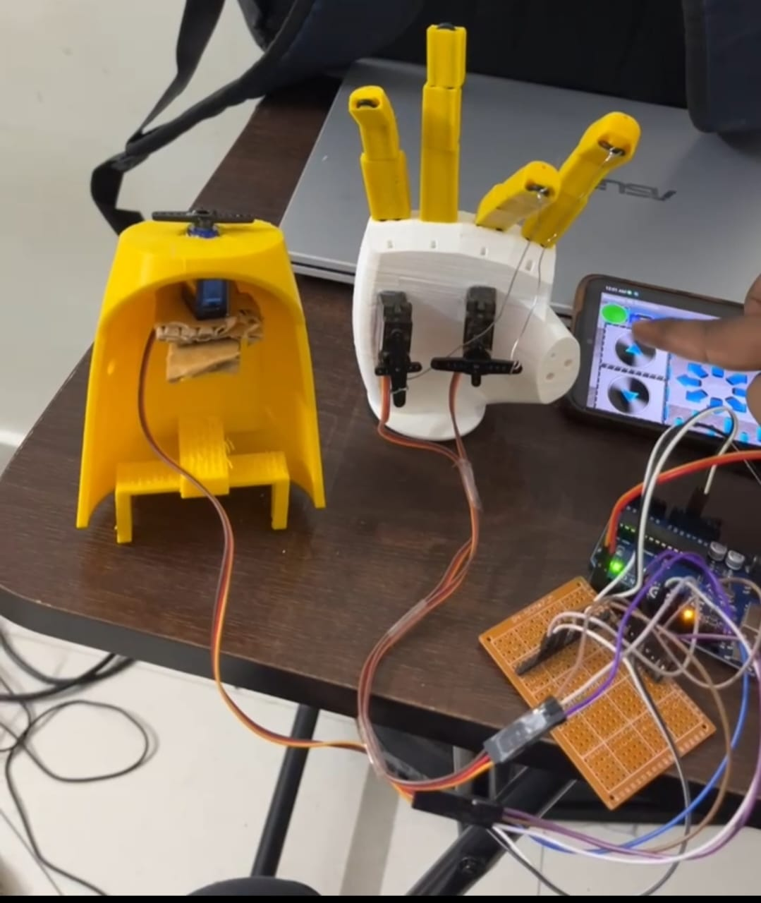
Images- Implementation
Fig : Images of the implementation and working of model.

Slide 14
Applications - Real Life
Assistive Daily Tasks: The robot hand can assist in performing daily tasks such as picking up objects, opening doors, turning knobs, or operating switches, enhancing independence and quality of life for individuals with physical disabilities.
Surgical Assistance: Assisting surgeons in performing delicate procedures with enhanced precision, reducing the risk of human error and improving patient outcomes.
Remote Inspection in Hazardous Environments: Deploying robot hands for remote inspection and manipulation in hazardous environments such as nuclear facilities, chemical plants, or disaster zones, ensuring the safety of human workers and minimizing exposure to risks.
Accessibility for Individuals with Disabilities: Motivation arises from the goal of promoting inclusivity and independence for individuals with physical disabilities. By offering a means to manipulate objects and perform tasks that might otherwise be challenging, smartphone-controlled robot hands empower users to overcome obstacles and participate more fully in daily activities, fostering a sense of autonomy and accomplishment.
In summary, the motivation to utilize smartphone-controlled robot hands arises from a variety of factors, including safety, accessibility, performance, learning, customization, and automation, all driven by the desire to achieve specific goals, improve outcomes, and enhance quality of life.

Slide 15
Results and Discussions
The prosthetic hand accurately responded to "open" and "close" commands transmitted via the smartphone application, demonstrating precise control.
When the user issued the "open" command through the smartphone application, the HC-05 Bluetooth module reliably transmitted the signal to the Arduino UNO microcontroller, initiating precise control signals to the servo motors. This led to smooth extension of the fingers, enabling the prosthetic hand to release objects or prepare for gripping tasks effectively.
Similarly, the execution of the "close" command prompted the servo motors to contract, seamlessly closing the fingers and facilitating a firm grip.
The HC-05 Bluetooth module maintained a reliable wireless connection, ensuring consistent command transmission without noticeable lag or errors.
The servo motors executed commands smoothly, resulting in coordinated and accurate finger movements for gripping and releasing objects.
The smartphone application provided an intuitive interface, making it easy for users to control the prosthetic hand's movements effectively.
The seamless interaction between the smartphone, Bluetooth module, Arduino UNO, and servo motors contributed to a user-friendly experience, enhancing the device's usability.

Slide 16
Conclusion
The project successfully demonstrated the functionality of a smartphone-controlled prosthetic hand.The HC-05 Bluetooth module provided stable and reliable wireless connectivity for command transmission.
The Arduino UNO and servo motors ensured precise and responsive finger movements in response to user commands.
The project's outcomes indicate potential for further improvements, such as integrating advanced sensors and more sophisticated control algorithms.
The user-friendly smartphone application enhanced accessibility, making it easy for users to control the hand intuitively. This practical and efficient design highlights the potential for further advancements, including the integration of advanced sensors and more sophisticated control algorithms, to expand the capabilities of the prosthetic hand.
Overall, the project lays a solid foundation for creating accessible, reliable, and functional prosthetic devices using readily available technology.

Slide 17

References
Yusoff, M.A.K., Samin, R.E. and Ibrahim, B.S.K., 2012. Wireless mobile robotic arm. Procedia Engineering, 41, pp.1072-1078.
Mohammed Ali, H., Hashim, Y. and A AL-Sakkal, G., 2022. Design and implementation of Arduino based robotic arm. International Journal of Electrical and Computer Engineering, 12(2),pp.1411-1411.
Safaric, R., Hedrih, I., Klobucar, R. and Sorgo, B., 2003, December. Remote controlled robot arm. In IEEE International Conference on Industrial Technology, 2003 (Vol. 2, pp. 1202-1207).IEEE.
Li-Hu Jhang, Carlo Santiago, Chian-Song Chiu, “Multi-sensor Based Glove Control of An Industrial Mobile Robot Arm”, International Automatic Control Conference (CACS), 2017.
Shamman Noor, Jamal Ahmed Shohan, Mashrura Sharmin Waresi, Sultanul Areffin Rhythm, Asif Ahmed, Asir Intisar Khan, Shaikh Anowarul Fattah, Celia Shahnaz, “Real Time Hand Movement Controlled Robotic Arm for Risk Prevention”, IEEE Region 10 Humanitarian Technology Conference (R10-HTC), 2017.
Keerthi Premkumar, Mr. K Gerard Joe Nigel, “Smart Phone Based Robotic Arm Control Using Raspberry Pi, Android and Wi-Fi”, IEEE Sponsored 2nd International Conference on Innovations in Information Embedded and Communication Systems (ICIIECS), 2015.
Ahmed, Anwer Sabah, Heyam A. Marzog, and Laith Ali Abdul-Rahaim. "Design and implement of robotic arm and control of moving via IoT with Arduino ESP32." International Journal of Electrical \& Computer Engineering (2021).
Bhargava, Ankur, and Anjani Kumar. "Arduino controlled robotic arm." In 2017 International conference of Electronics, Communication and Aerospace Technology (ICECA). IEEE, 2017.

Slide 18

References
Lee, Seong Ro. "A Simple and Efficient Wireless Control Protocol for Small Scale Robotic Arm." International Journal of Future Generation Communication and Networking 7 2014.

Slide 19

Thank you !!!!!

